Slide 1
Avoiding the Problems
Based on Chapter 3 of Bennett, McRobb and Farmer:
Object Oriented Systems Analysis and Design Using UML, (2nd Edition), McGraw Hill, 2002.
03/12/2001
© Bennett, McRobb and Farmer 2002

Slide 2
In This Lecture You Will Learn:
The stages in the waterfall life cycle
About prototyping and incremental life cycles
The importance of project management
How users may be involved in a project
The role of CASE tools in systems development
© Bennett, McRobb and Farmer 2002

Slide 3
Problem Solving Model
Main phases are
  Data gathering
  Problem redefinition
  Finding ideas
  Finding solutions
  Implementation
    These focus on understanding what the problem is about
    Concerned with understanding more about the nature of the problem and possible solutions
© Bennett, McRobb and Farmer 2002
Notes:
Problem Solving Model:

Slide 4
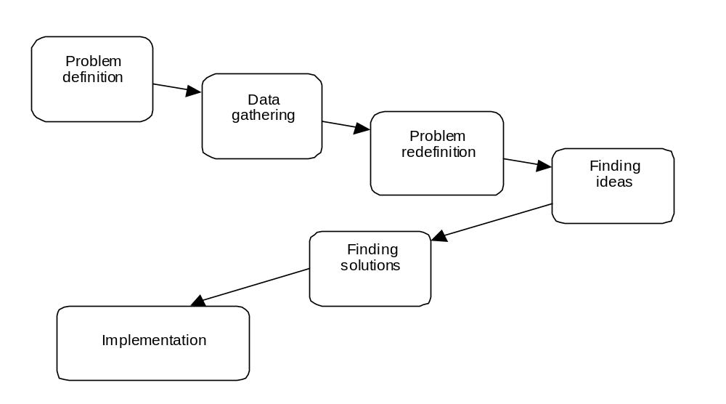
Problem Solving Model
General problem solving model (adapted from Hicks, 1991).
© Bennett, McRobb and Farmer 2002

Slide 5
Project Life Cycles
A distinction should be made between
  Systems development which incorporates human, software and hardware elements
  Software development which is primarily concerned with software systems
Two important phases are
  Strategic Information Systems Planning
  Business Modelling
© Bennett, McRobb and Farmer 2002
Notes:
Strategic Information Systems Planning. As we saw in Chapter 1, information systems work within the context of an organization and must satisfy its current requirements as well as providing a basis from which future needs can be addressed. In order to do this, strategic plans are developed for the organization as a whole and within their context a strategic view of information systems needs can be formed. For example, in the Agate case study a strategic decision may be made to target multinational companies for international advertising campaigns. This has consequences for campaign management and its supporting information systems.
Business modelling. In order to determine how an information system can support a particular business activity it is important to understand how the activity is performed and how it contributes to the objectives of the organization. Campaign management is an important business function for Agate and it should be modelled in order to determine how it is carried out, thus providing some of the parameters for subsequent information systems development.

Slide 6
Waterfall Life Cycle
The traditional life cycle (TLC) for information systems development is also known as the waterfall life cycle model
  So called because of the difficulty of returning to an earlier phase
The model shown here is one of several more or less equivalent alternatives
  Typical deliverables are shown for each phase
© Bennett, McRobb and Farmer 2002

Slide 7
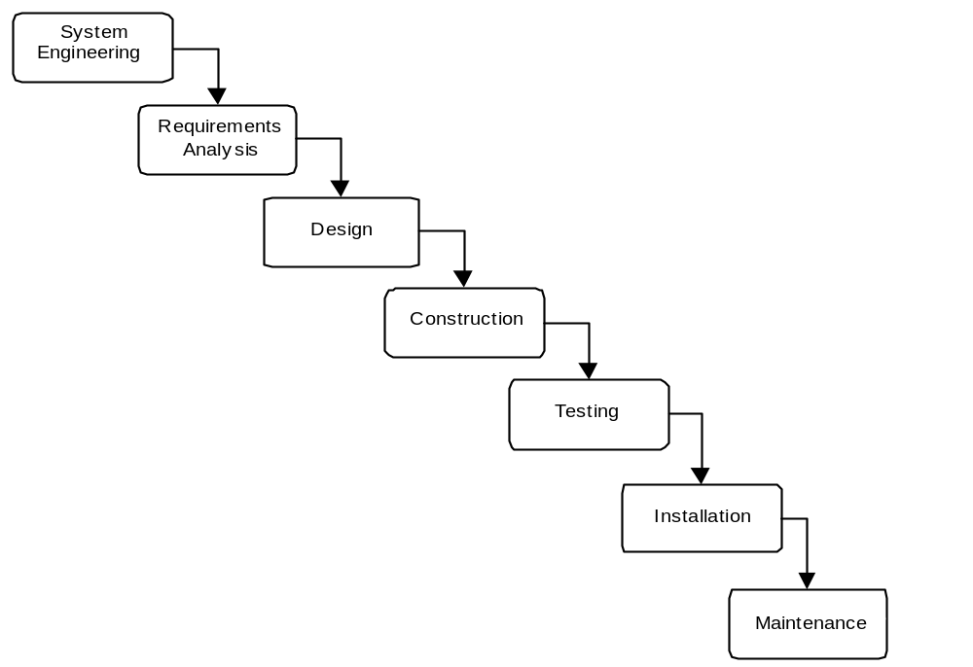
Traditional
Life Cycle
© Bennett, McRobb and Farmer 2002

Slide 8
TLC Deliverables
System Engineering
  High Level Architectural Specification
Requirements Analysis
  Requirements Specification
  Functional Specification
  Acceptance Test Specifications
Life cycle deliverables (adapted from Sommerville, 1992).
© Bennett, McRobb and Farmer 2002

Slide 9
TLC Deliverables
Design
  Software architecture specification
  System test specification
  Design specification
  Sub-system test specification
  Unit test specification
Life cycle deliverables (adapted from Sommerville, 1992).
© Bennett, McRobb and Farmer 2002

Slide 10
TLC Deliverables
Construction
  Program code
Testing
  Unit test report
  Sub-system test report
  System test report
  Acceptance test report
  Completed system
Life cycle deliverables (adapted from Sommerville, 1992).
© Bennett, McRobb and Farmer 2002

Slide 11
TLC Deliverables
Installation
  Installed System
Maintenance
  Change requests
  Change request report
Life cycle deliverables (adapted from Sommerville, 1992).
© Bennett, McRobb and Farmer 2002

Slide 12
Problems with TLC
Real projects rarely follow such a simple sequential life cycle
Iterations are almost inevitable
Time elapses between system engineering and the final installation
The design is unresponsive to business changes during the project
© Bennett, McRobb and Farmer 2002

Slide 13
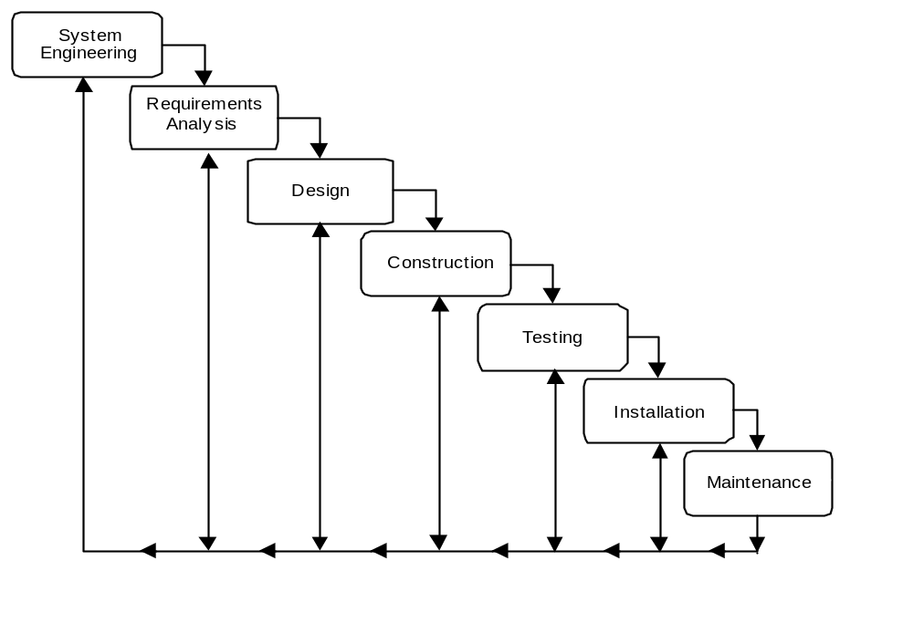
TLC with
Iteration
Iteration added to resolve some of the problems
© Bennett, McRobb and Farmer 2002

Slide 14
Strengths of TLC
Tasks in phases may be assigned to specialized teams
Project progress evaluated at the end of each phase
Manage projects with high levels of risks
© Bennett, McRobb and Farmer 2002

Slide 15
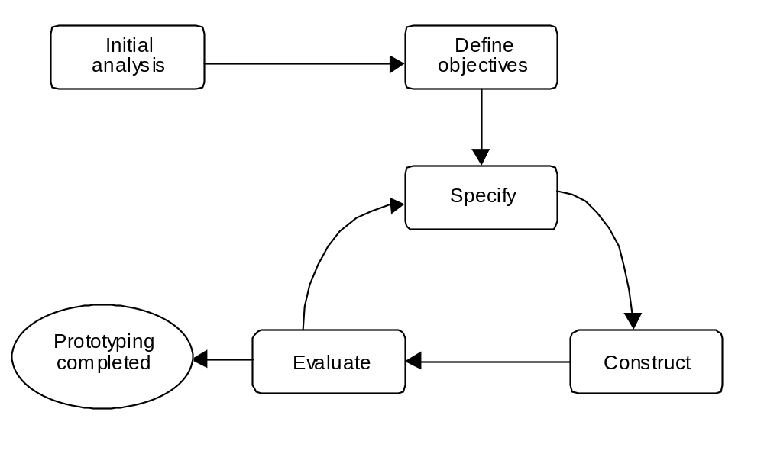
Prototyping Life Cycle
© Bennett, McRobb and Farmer 2002
Notes:
Perform an initial analysis. All software development activity utilizes valuable re­sources. Embarking upon a prototyping exercise without some initial analysis is likely to result in an ill-focused and unstructured activity producing poorly designed software.
Define prototype objectives. Prototyping should have clearly stated objectives. A proto­typing exercise may involve many iterations, each iteration resulting in some improv­ement to the prototype. This may make it difficult for the participants in a prototyping exercise to determine if there is sufficient value to continue the prototyping. However, with clearly defined objectives it should be possible to decide if they have been achieved.
Specify prototype. Although the prototype is not intended for extended operation it is important that it embodies the requisite behaviour. It is almost certainly the case that the proto­type will be subject to modification and this will be easier if the software is built according to sound design principles.
Construct prototype. Since it is important that prototype development is rapid, the use of a rapid development environment is appropriate. For example, if an interactive system is being prototyped, environments such as DelphiTM or Visual Basic® can be most effective.
Evaluate prototype and recommend changes. The purpose of the prototype is to test or explore some aspect of the proposed system. The prototype should be evaluated with respect to the objectives identified at the beginning of the exercise. If the objectives have not been met then the evaluation should specify modifications to the prototype so that it may achieve its objectives. The last three stages are repeated until the objectives of the prototyping exercise are achieved.

Slide 16
Prototyping—Advantages
Early demonstrations of system functionality help identify any misunderstandings between developer and client
Client requirements that have been missed are identified
Difficulties in the interface can be identified
The feasibility and usefulness of the system can be tested, even though, by its very nature, the prototype is incomplete
© Bennett, McRobb and Farmer 2002

Slide 17
Prototyping—Problems
The client may perceive the prototype as part of the final system
The prototype may divert attention from functional to solely interface issues
Prototyping requires significant user involvement
Managing the prototyping life cycle requires careful decision making
© Bennett, McRobb and Farmer 2002

Slide 18
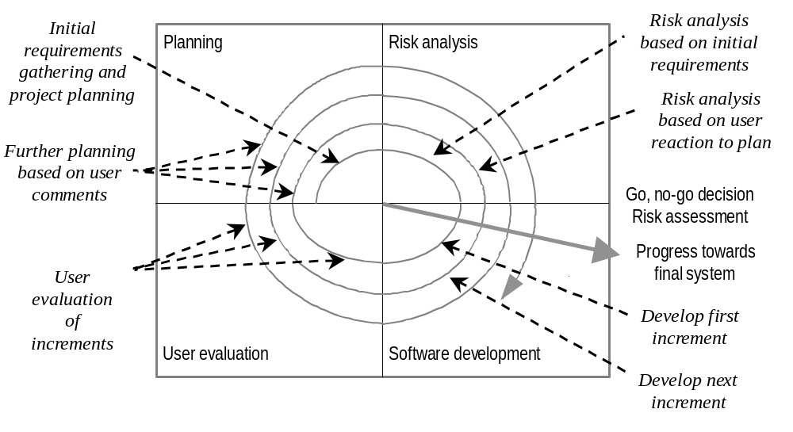
Spiral Model & Incremental Development
© Bennett, McRobb and Farmer 2002
Notes:
Boehm’s (1988) spiral model can be viewed as supporting incremental delivery. However, Gilb (1988) argues that the spiral model does not fully support his view of incremental development, as there are aspects of systems development that it does not emphasize or include. These are as follows:
• the production of high-value to low-cost increments;
• the delivery of usable increments of 1% to 5% of total project budget;
• a limit to the duration of each cycle (e.g. one month);
• a measure of productivity in terms of delivered functionality or quality improvements;
• an open-ended architecture that is a basis for further evolutionary development.

Slide 19
Unified Software Development Process
Captures many elements of best practice
Main phases
  Inception is concerned with determining the scope and purpose of the project
  Elaboration focuses requirements capture and determining the structure of the system
  Construction's main aim is to build the software system
  Transition deals with product installation and rollout
© Bennett, McRobb and Farmer 2002

Slide 20
Project Phases
Workflows
Requirements
Analysis
Design
Implementation
Test
Inception
1
2
3
Size of square relative to time spent on workflow
Elaboration
4
5
Construction
6
7
8
Transition
9
10
Iterations within each phase
© Bennett, McRobb and Farmer 2002

Slide 21
User Involvement
Users can be involved in various ways
  As part of the development team (DSDM)
  Via a consultative approach
  In fact gathering
© Bennett, McRobb and Farmer 2002

Slide 22
Computer Aided Software Engineering
CASE tools typically provide a range of features including
  checks for syntactic correctness
  repository support
  checks for consistency and completeness
  navigation to linked diagrams
  layering
  requirements tracing
  report generation
  system simulation
  performance analysis
  code generation
© Bennett, McRobb and Farmer 2002

Slide 23
References
Hicks (1991)
Sommerville (1992) and Pressman (1994)
Jacobson, Booch and Rumbaugh (1999)
Chapters 5 and 22 of Bennett, McRobb and Farmer include more detail about the Unified Process
(For full bibliographic details, see Bennett, McRobb and Farmer)
© Bennett, McRobb and Farmer 2002

